Slide 1
GODEX-NWP 2018
Nigel Atkinson, Met Office
27-30 November 2018, New Delhi, India

Slide 2
Contents
NWP model and infrastructure capabilities
Changes in data usage since last GODEX-NWP
Report from RTH Exeter

Slide 3
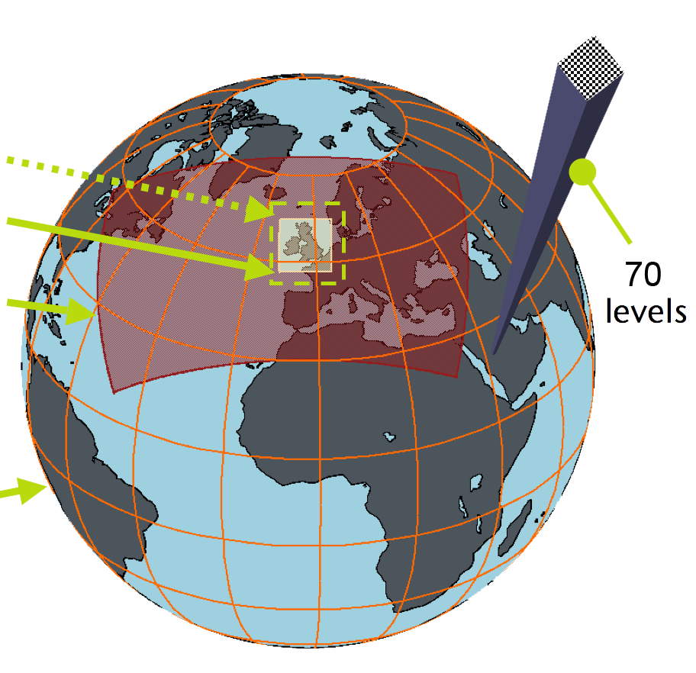
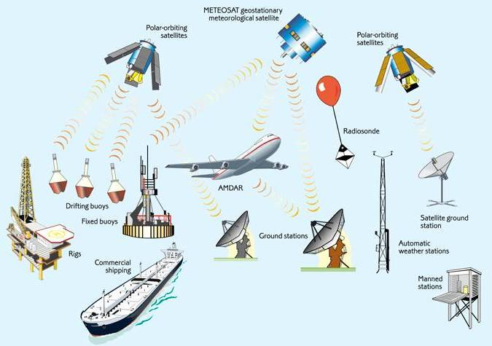
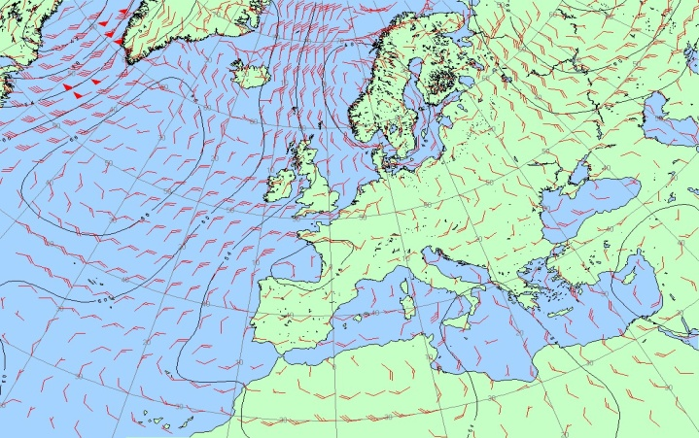
Forecasting Process
UK 1.5km
+UK ensemble
Regional 4km
+Regional ensemble
Observations
Global 10km
+Global ensemble

Slide 4
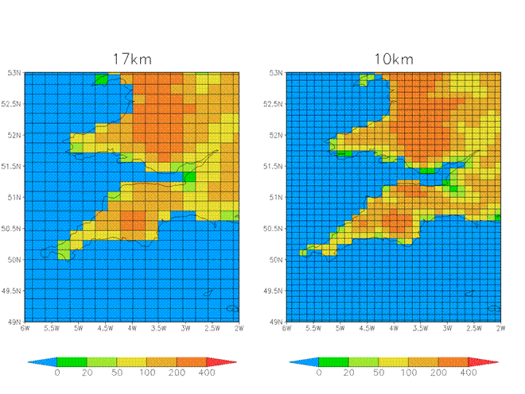
Spring 2017 – global model resolution upgrade

Slide 5
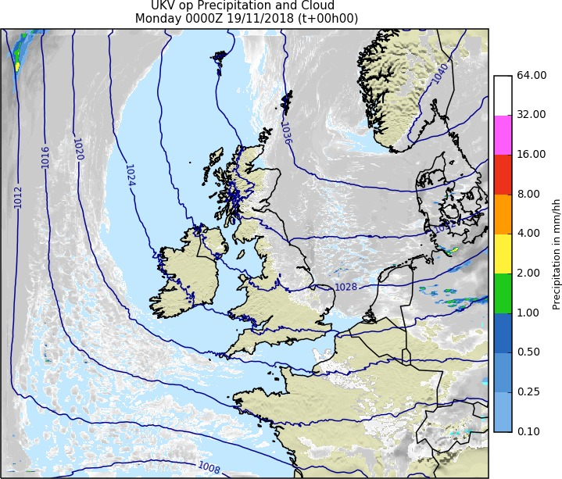
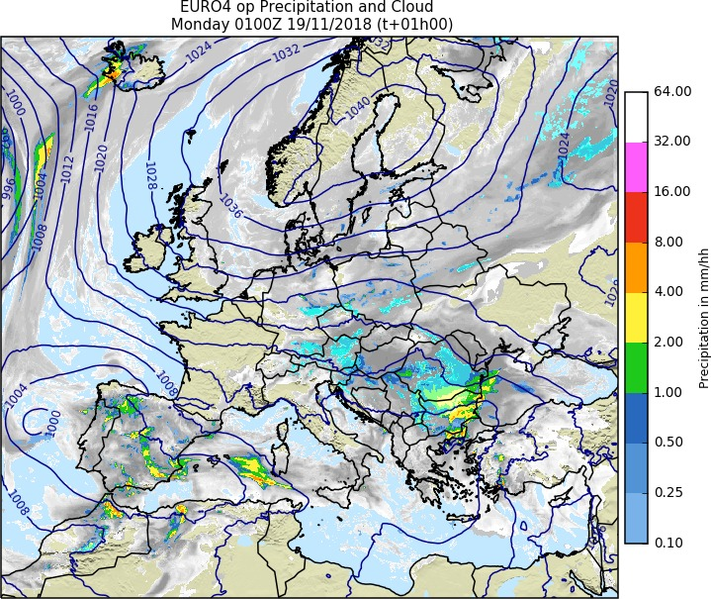
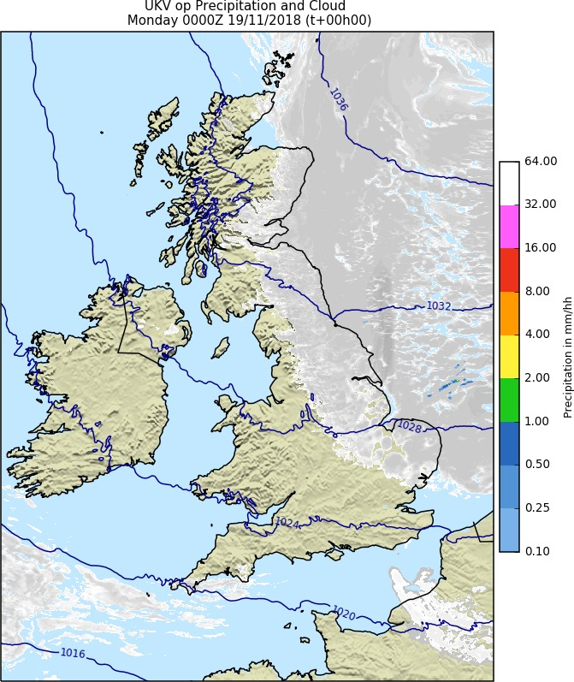
Regional models
UKV model: 1.5km inner area, 4km at edge
EURO4 – 4km downscaled global
To be retired in 2020
UKV: 1.5km area

Slide 6
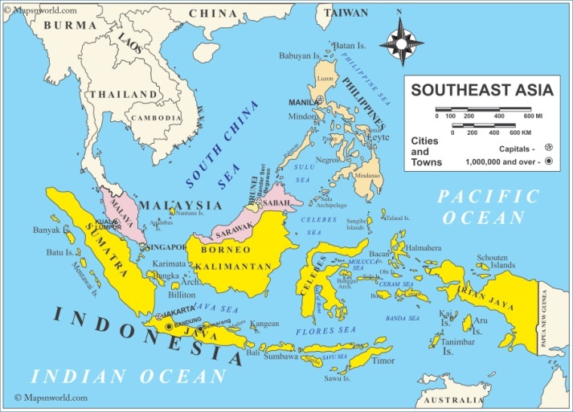
Southeast Asia project – Newton Fund
Newton Fund is part of UK government’s official development assistance (ODA) budget. Aims to develop science and innovation partnerships that promote the economic development and social welfare of partner countries, plus supporting development challenges globally
Project started in 2016, initially with Philippines and Malaysia with Indonesia starting in 2017.
Strong focus on weather timescales and high impact weather with links through to CS models
The 3 countries are part of the ‘Maritime Continent’ – the heat engine of the tropics

Slide 7
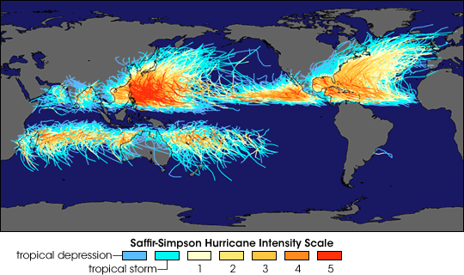
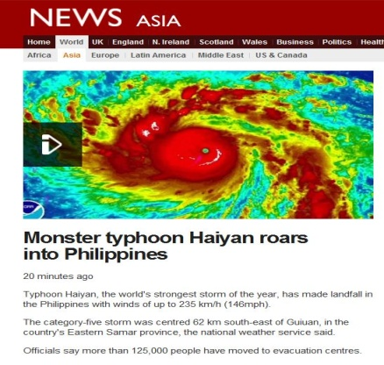
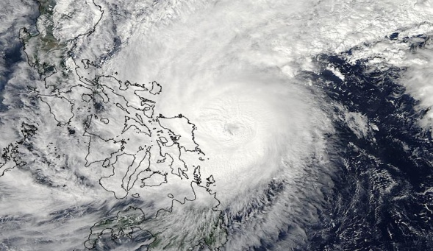
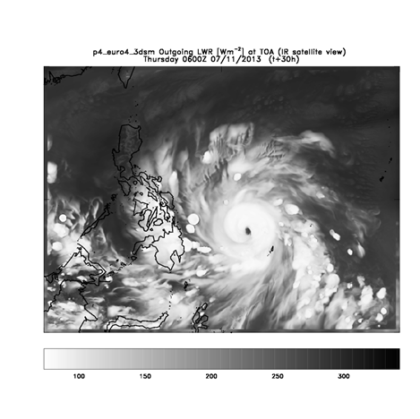
Satellite
4km Model

Slide 8
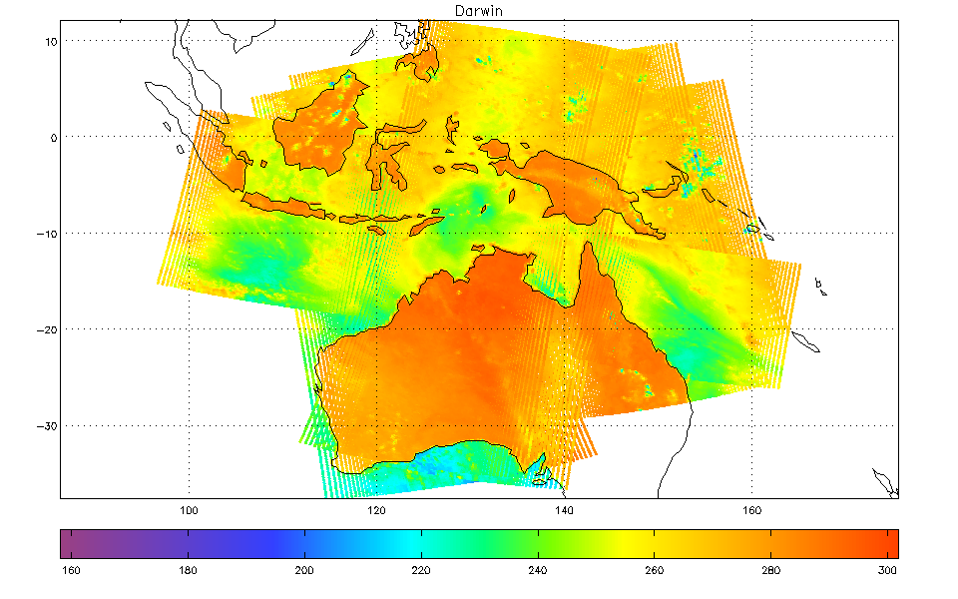
Data requirements for SE Asia project
For the 4km SE Asia model (and its predecessor SINGV), with hourly cycling, timely satellite data is essential
We make particular use of DBNet MHS and IASI data from Singapore and Darwin stations. See later talk on DBNet.
24 hours of MHS data from Darwin

Slide 9
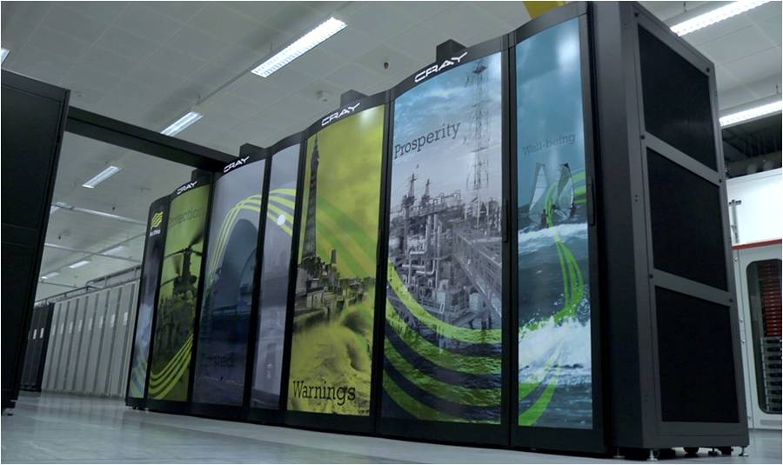
Supercomputer
Installed 2017
Old
Systems in 3 computer halls (two at HQ and one in new building in Exeter Science Park)
Hall 3 system completed spring 2017
Hall 3

Slide 10
Satellite Data Assimilated (1)
Observation type | Satellites | NWP models
AMSU/MHS radiances | 4 NOAA + Metop-A/B | G, UK
HIRS clear radiances | 2 NOAA + Metop-A/B | G
IASI and AIRS clear+cloudy radiances | Metop-A/B + Aqua | G,UK
ATMS & CrIS radiances | Suomi NPP/NOAA-20 | G, UK
Geo imager clear IR radiances | METEOSAT-11, GOES-W, Himawari-8, METEOSAT-8 | G, UK
GPS RO bending angles Ground based ZTD | 2 COSMIC, Metop/GRAS, TerraSAR-X, CNOFS, GNOS All GNSS satellites | G G, UK

Slide 11
Satellite Data Assimilated (2)
Observation type | Satellites | NWP models
AMVs – Geo | 5 Geo satellites | G, UK
AMVs – Polar MODIS and AVHRR | Aqua, Terra, NOAA, Metop-A/B | G
Scatterometers: sea-surface winds | Metop/ASCAT-A&B, ScatSat | G, UK
MW imager sea-surface winds: Windsat, AMSR-2, GMI | Coriolis, GCOM-W1, GPM | G
SEVIRI cloud height/amount | Meteosat | UK
SSTs: AVHRR, AMSR-E… | NOAA, Metop, Aqua | G, UK
Soil moisture: ASCAT | Metop-A/B | G, UK
Sea ice: SSMIS, AMSR-2 | DMSP,GCOM via OSI SAF | G
Snow cover | NOAA IMS | G

Slide 12
Satellite radiance data – spring 2017
in a 6h assimilation window
ATOVS=
AMSUA + MHS
AIRS
MT-Saphir
IASI
ATMS
MWHS-2
CrIS
AMSR-2
SSMIS

Slide 13
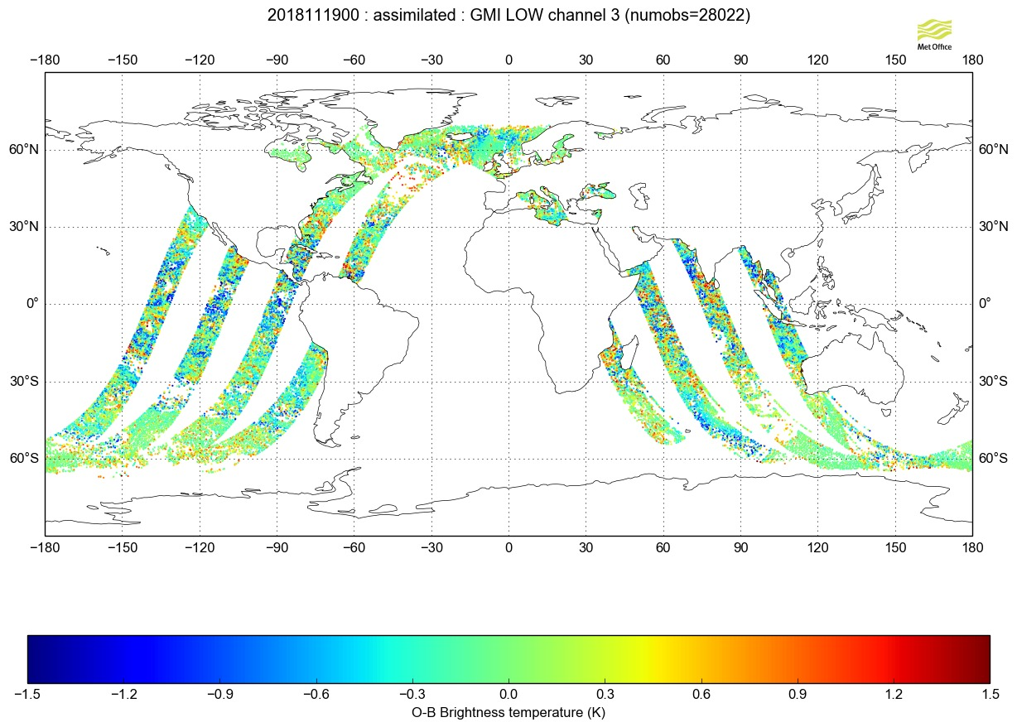
Recently added GMI (microwave imager)
MWRI (FY-3B and 3C) coming soon: in trials (FY-3D will follow later)

Slide 14
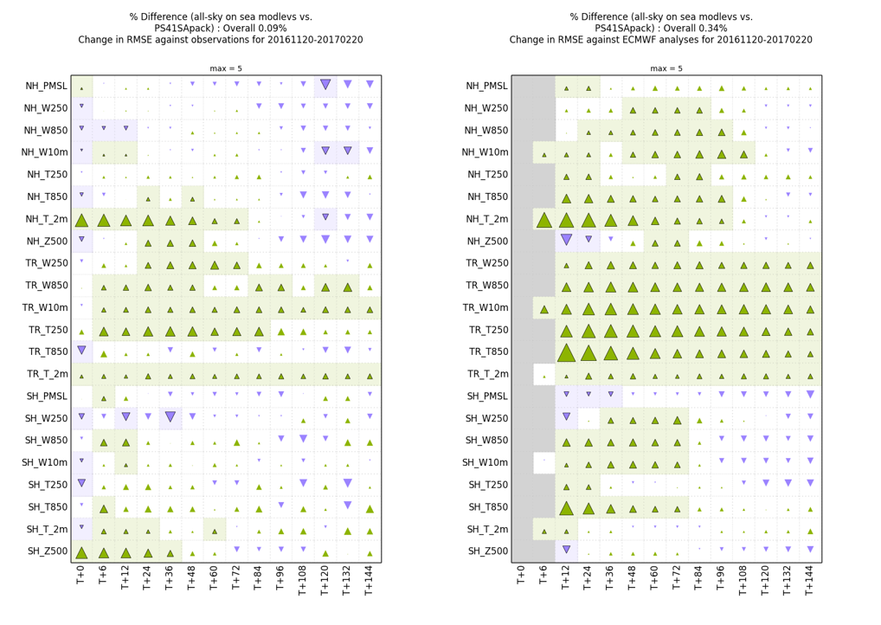
All sky microwave assimilation
Introduction of moisture incrementing operator and variable observation error allows assimilation of AMSU-A and ATMS in cloudy (non-precipitating) conditions over sea
Significant positive impact on forecast scores

Slide 15
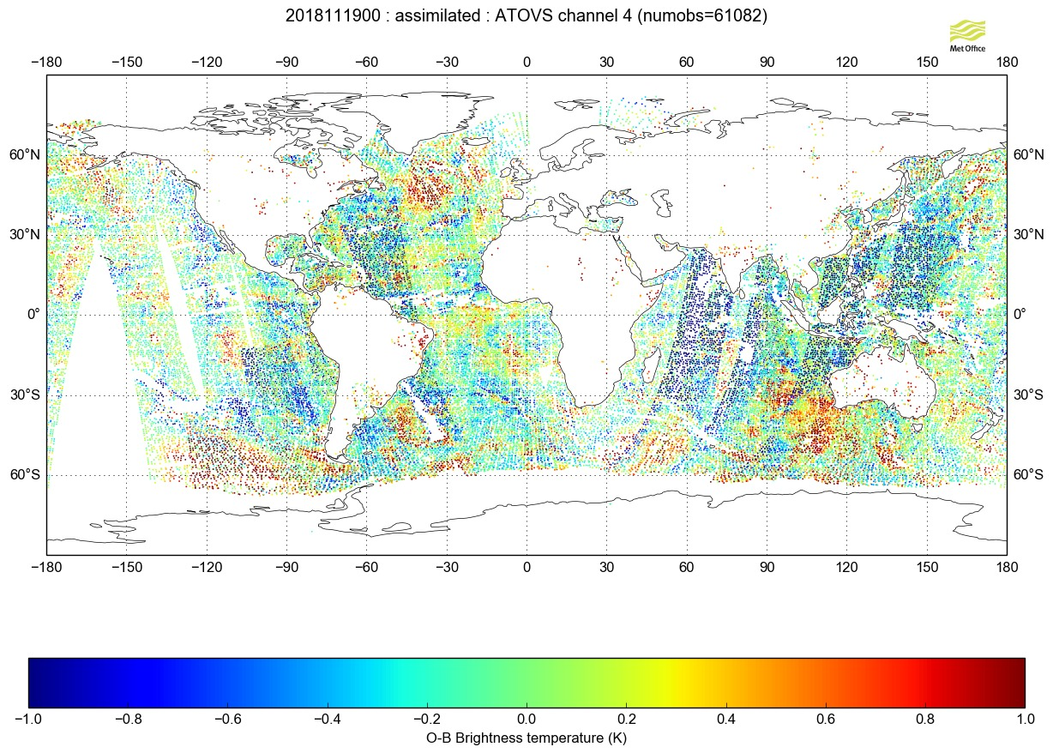

Slide 16
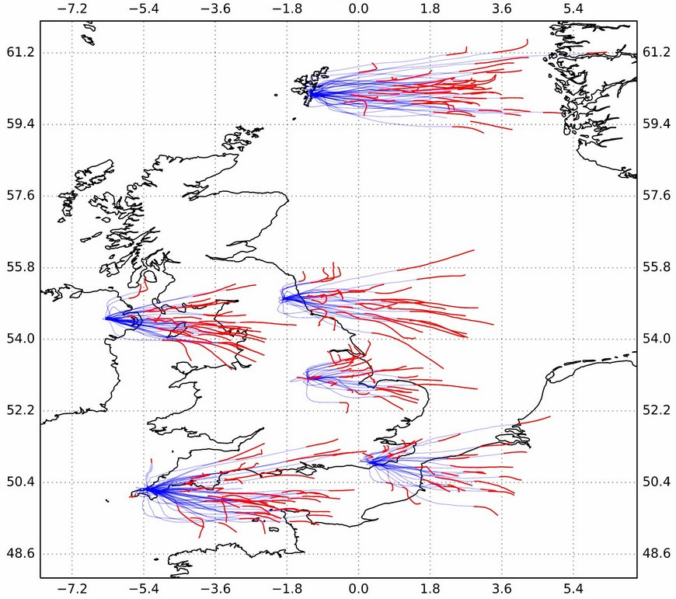
Developments in non-satellite observations
Radiosonde descent data
Preparing to assimilate descent data (shown in red)
Quality is good
BUFR sequence is defined, and a real-time feed has been set up between Met Office, ECMWF and Washington

Slide 17
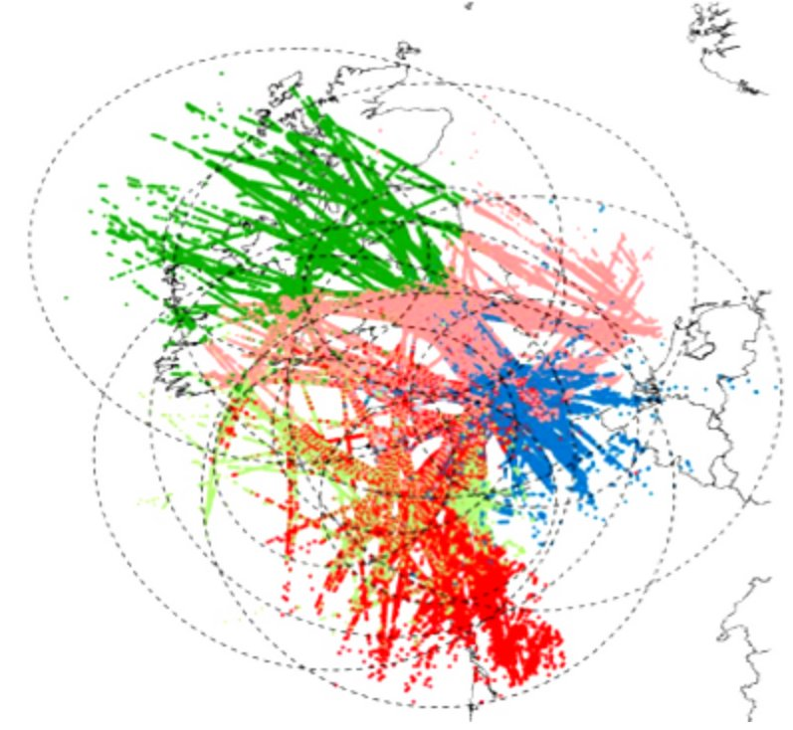
Developments in non-satellite observations (2)
Wind profiler retirement and replacement by MODE-S
5 of the 6 Met Office wind profilers are approaching end of life and are being retired
MODE-S signals from aircraft are freely available and contain ground speed and air speed information – hence compute winds
Quality comparable to AMDAR
Assimilate MODE-S from Jan 2019
Plan to use in Africa also

Slide 18
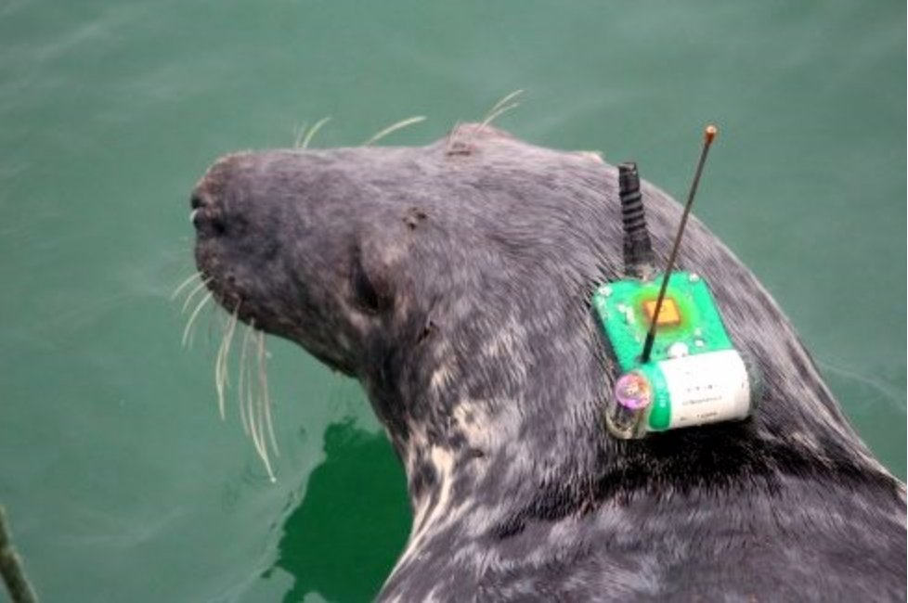
Developments in non-satellite observations (3)
Instrumented seals
Seven grey seals tagged in spring 2018 have delivered 3,326 temperature profiles to date
Assimilated into FOAM ocean models
Helps with data sparse areas in the European North West Shelf model

Slide 19
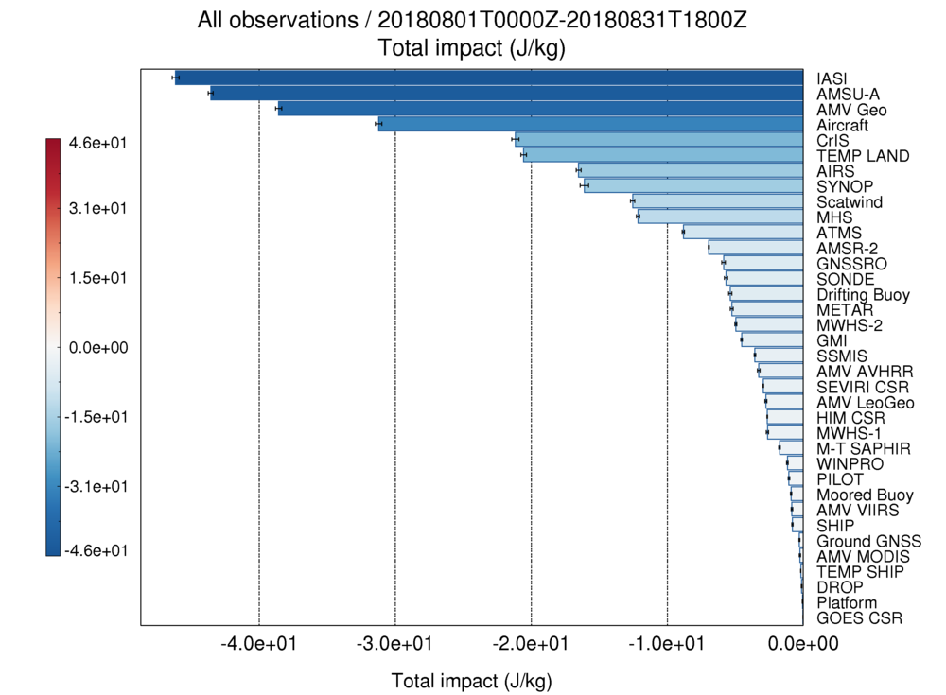
Total impact of observations by type
(August 2018)
Impact plots
Forecast sensitivity to observations (FSO) – useful guidance but not the same as a data denial experiment!

Slide 20
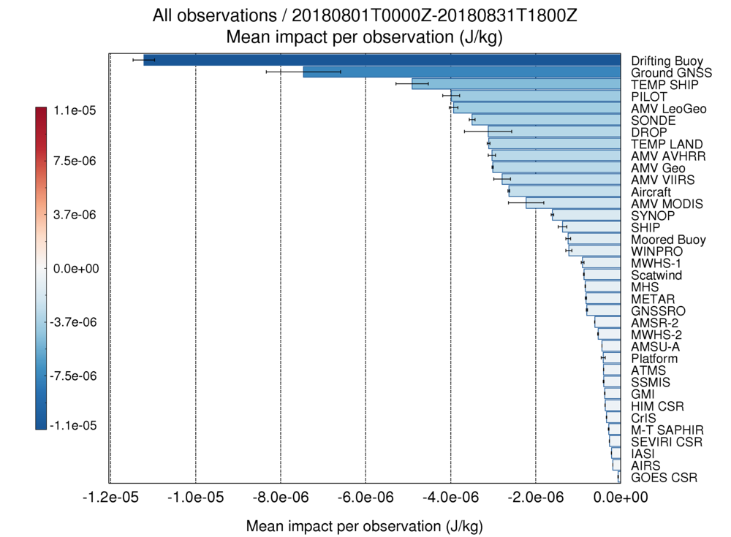
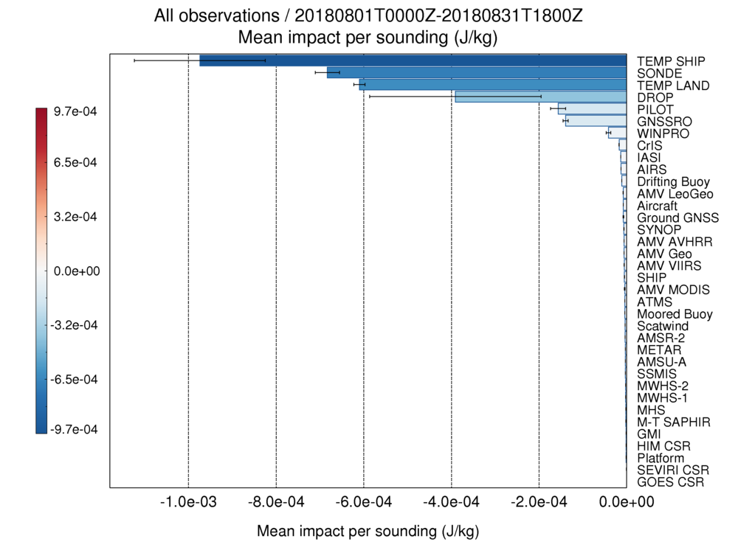
Mean impact of observations by observation/sounding
(August 2018)
Impact plots

Slide 21
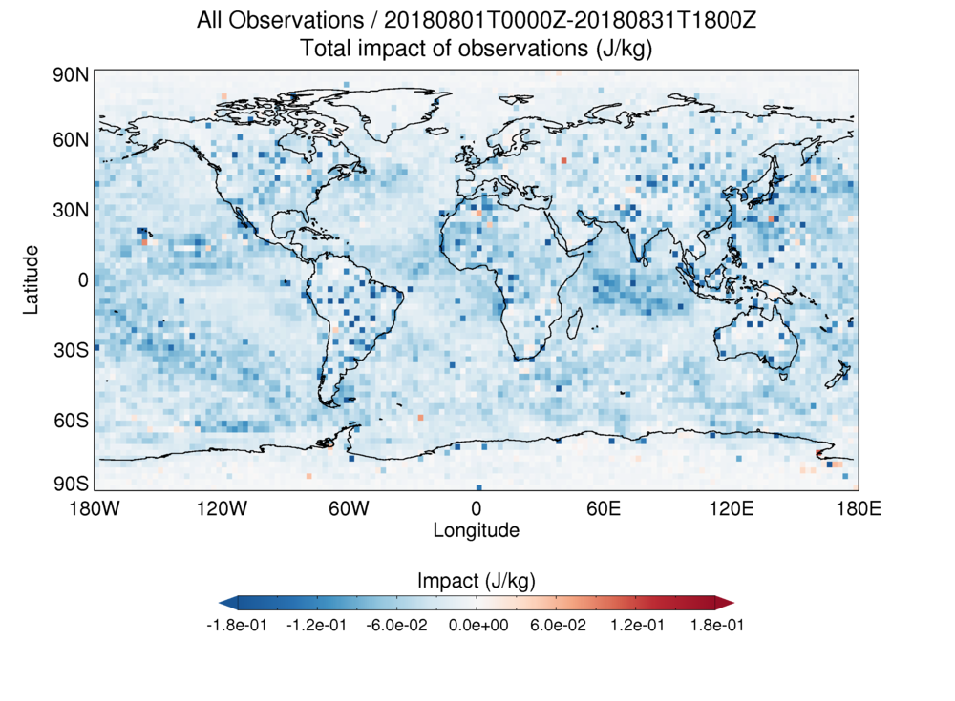
Total impact of all observations
(August 2018)
Impact maps

Slide 22
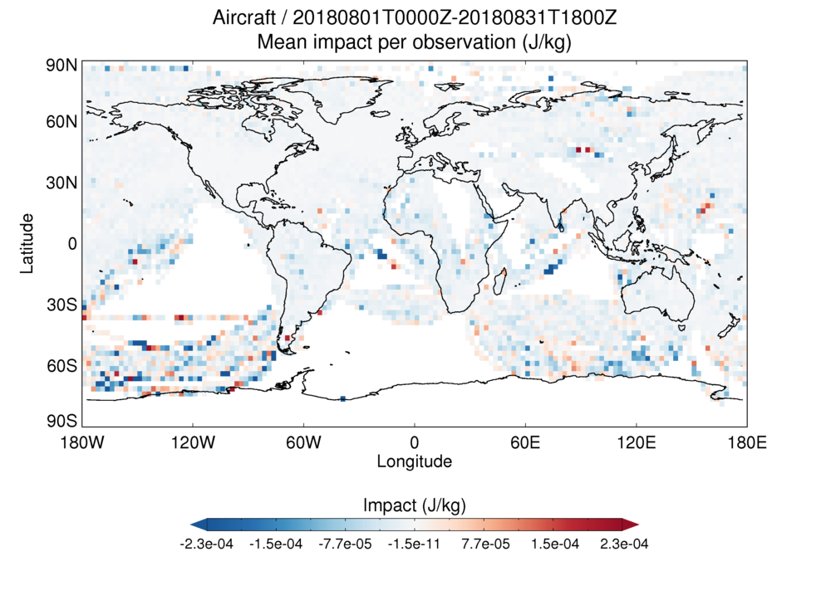
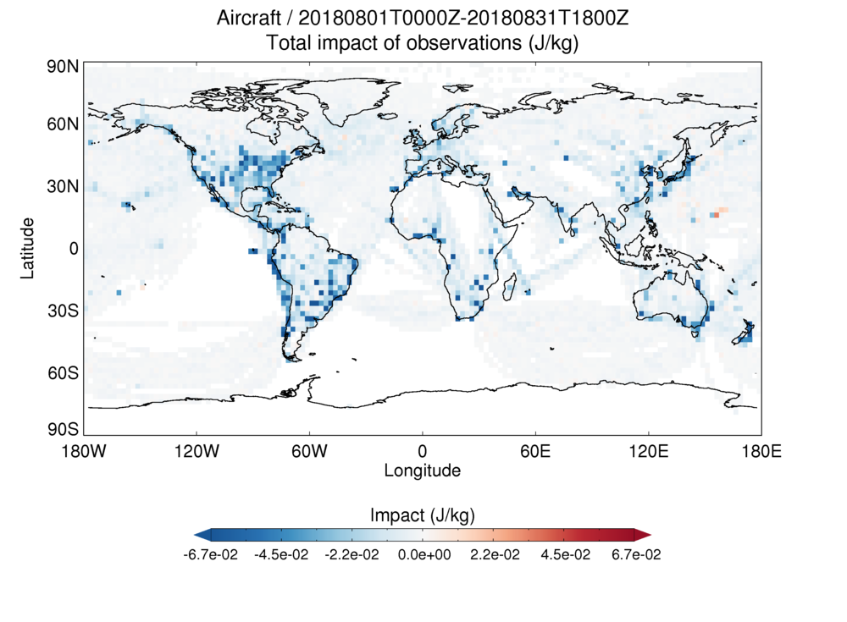
Mean impact of all aircraft observations
(August 2018)
Impact maps
Largest impact per observation in poorly observed regions
Observations are most beneficial in data-sparse regions

Slide 23
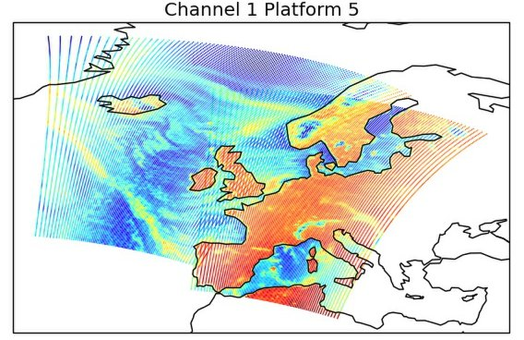
Launched satellites awaiting data
Metop-C
Commissioning started
ADM-Aeolus
Expecting data very soon
FY-4A
GIIRS (hyperspectral sounder) – useful preparation for MTG-IRS
Lightning sensor data ?
FY-3D
Awaiting start of data dissemination
Awaiting DB package
Sentinel-5P (TROPOMI)
Of interest for air quality
Sentinel-3B
MHS data from Metop-C
from cal/val partner feed (EUMETCast)

Slide 24
Future satellites
FY-3E – early morning orbit
Metop-SG-A1 and B1 (2022)
MTG-I1 (2021) and S1 (2023)
Meteor-M-N2-2
OceanSat-3
Successor to GCOM-W ? AMSR-2 is important for SST
Korean microwave mission ?
U.S. military (successors to DMSP)?
Smallsats?
Others …

Slide 25
Where do we get meteorological data from?
EUMETCast
EUMETSAT
GTS
(national met. services)
Satellite direct broadcast
Met Office
NESDIS link
now internet based
Satellite agencies e.g. NASA, ESA
Others
e.g. research organisations

Slide 26
What level of data do we need to handle?
Raw bit stream (e.g. direct broadcast)
Level 1b – raw counts with calibration coefs
Level 1c – brightness temperature, on original measurement grid
Level 1.5 – MSG channel data
Level 2 – meteorological products (e.g. SST), on original measurement grid
Level 3 – gridded products
Formats?
Bespoke binary
BUFR and GRIB
NetCDF4 / hdf5
NetCDF3
hdf-eos
HRIT (for MSG)
Others ….

Slide 27
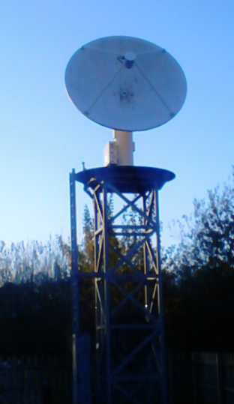
Direct broadcast reception
Still using two Spacetec (MEOS) systems on site at Exeter
But one is approaching end of life, so considering options
NOAA-15/18/19, S-NPP, NOAA20, Metop-A/B/C, Terra, Aqua, FY3B/3C
Will process FY-3D when software is available
Processing packages:
AAPP (NWP SAF)
CSPP (UW/NOAA)
FY3L0pp / FY3L1pp
3.2m Yentai
2.4m Orbital

Slide 28
Report from RTH Exeter GTS connectivity
Connections to RTHs:
Brasilia, Melbourne, Moscow, New Delhi, Offenbach,
Pretoria, Rome, Tokyo, Toulouse, Washington
Connections to NMCs:
Brussels, Copenhagen, Dar es Salaam, De Bilt, Dublin,
Lisbon, Madrid, Montreal, Oslo, Reykjavik
Daily traffic:
Input 27 GBytes per day
Output 60 GBytes per day
99.99% availability between April 2017 and October 2018.

Slide 29
GISC Exeter WIS connectivity
Daily traffic statistics:
Ingesting 9.3GBytes of data into 24hr Cache.
Metadata catalog contains 101,543 records.
Daily catalog synchronisation with GISCs & DCPCs:
Beijing, Brasilia, ECMWF, Jeddah, Melbourne, Moscow,
Offenbach, Seoul, Tehran, Tokyo, Toulouse
97.96% availability between April 2017 and October 2018.
Notes:
WIS is replacing the GTS. A GISC (global information systems centre) has a data cache containing 24 hours of essential data, plus a metadata catalogue describing data available from all national met centres.

Slide 30
NESDIS link
We used to have a dedicated link to NESDIS, but this is now Internet-based (connecting to PDA).
Carries some data types that are not available by other means, including:
Aqua AIRS and AMSU-A global data (BUFR)
SSMIS UPP data (BUFR)
ATOVS level 1b (native format – useful for monitoring)
GOES CSR
Some of these datasets are forwarded to other centres

Slide 31
Present Data types on NESDIS Link
Data Type | Platform | File header | MB /day | Files
AMSU-A Level 1B | NOAA-ATOVS | nss.amax | 139 | 88
AMSU-B Level 1B | NOAA-ATOVS | nss.ambx | 97 | 15
HIRS Level 1B | NOAA-ATOVS | nss.hirx | 313 | 88
MHS Microwave Humidity Sounder | NOAA-ATOVS | nss.mhsx | 402 | 73
HIRS Level 1B (AVHRR mapped to HIRS grid) | NOAA-ATOVS | npr.atav | 116 | 56
AIRS Brightness temperatures | NASA –EOS-2 (Aqua) | npr.aibt | 168 | 243
AMSU-A Brightness temperatures | NASA –EOS-2 (Aqua) | npr.aubt | 9 | 234
SSM/I Brightness temperatures | DSMP | npr.sdrr | 67 | 13
SSMIS Level 1C | DSMP | npr.td{E,I,L,U}b | 1178 | 292
SSMIS UPP | DSMP | npr.tdup | 412 | 59
Ozone, retrieved profiles and/or total column from SBUV | DSMP | prd.ozone.pmf | 2 | 14
WindSat |  | NPR_E068.WS | 0 | 0
COSMIC |  | bfrPrf_C00{1,2,4,5,6} | 3 | 282
CSBT |  | T_JUTX | 28 | 21
Total (wef 25 October 2018) |  |  | 2934 | 1478
Notes:
Overall decrease of about 1.5GByte per day since Sept 2015.
Decreases in traffic for:
SSMI/S level 1C & UPP

Slide 32
Present Data Volumes NESDIS Link

Slide 33
Data migration away from traditional alphanumeric codes (TAC)
The Met Office has ceased to distribute land & SHIP SYNOP, CLIMAT and AMDAR data in TAC format, replacing them with BUFR format data.
So far, very few centres have ceased transmission of TAC format data. The main issues are:
Variable quality of conversion applications being used.
Differing interpretations of the various BUFR templates.
Poorly converted locations information.
Lack of funding to perform ‘grass roots’ data migration activity.
The Met Office is:
Contacting all recipients of TAC form data, to determine the impact of the change.
Providing links to a number of available converters that customers can use to convert TDCF data back to TAC.
The next conversion project is now underway, migrating aviation OPMET data to XML format – iWXXM.
Unlike TAC to BUFR, all non-Met Office OPMET data converted from XML back to TAC is limited to internal use only and cannot be distributed outside of the organisation.
Stricter control on data will place onus on users of the OPMET data to migrate to using the XML formats.
Notes:
WMO is migrating many traditional alphanumeric code (TAC) formats to BUFR format. ICAO now migrating OPMET data from TAC to XML.
Met Office provides conversion of TAC to BUFR/XML and backward compatibility by converting BUFR/XML to TAC.

Slide 34
Thank you! Questions?

